Slide 1

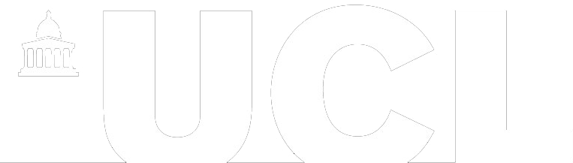
Workplace of the future
NATHALIE VON HUTH:
nathalie.huth.14@ucl.ac.uk
LAMAN MAMMADOVA:
laman.mammadova.14@ucl.ac.uk
Notes:
Laman

Slide 2

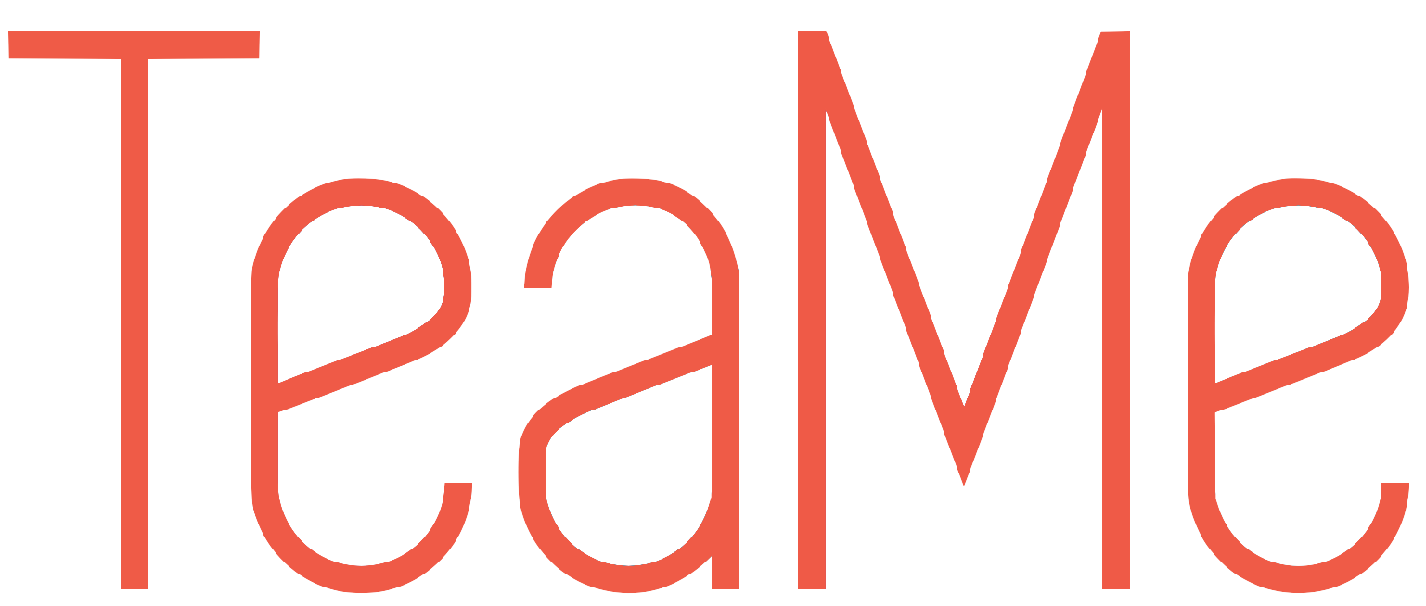
Connect with your co-workers…
Notes:
Tali
Today more and more companies are starting to move over to remote working, where the employees can work from home or other places rather in an office. Working remotely has several benefits for both the company and for the individual. It reduces cost of space and equipment, decreasing commuting time, flexible work hours and keeping a balanced life style. But there is also problems with remote working…

Slide 3

Problem
Remote
Less social
Team Work
Notes:
Build whatever we wanted
Competitors
Laman

Slide 4


Key Requirements
Login
Create Team
News feed
Messaging
TeaRoom
User Page
Mood status
Sharing location
Sharing status
Notes:
Laman

Slide 5
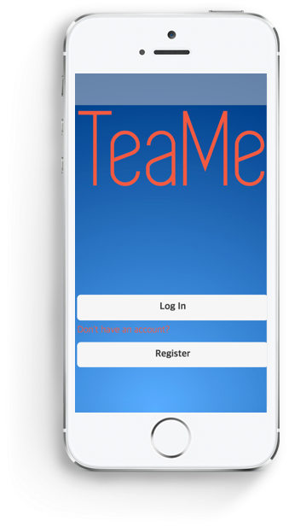
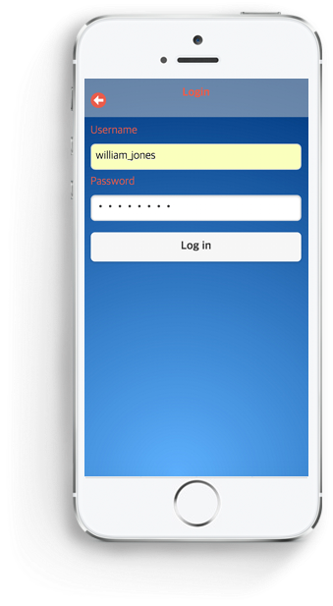
Login
Notes:
Let me walk you through how the user interface of the app looks like and how it works.
This is the first page you meet when you log in where you can choose between logging in or registering. The login is important in order to protect user information.
Nathalie

Slide 6
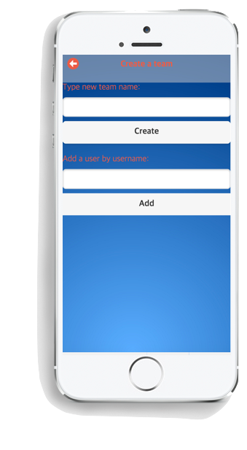
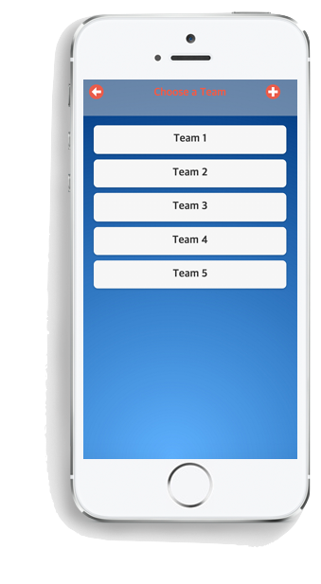
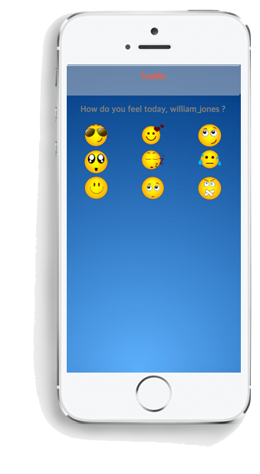
Teams & Feelings
Notes:
When you have logged in you will be able to either create a team, or if you’re already in a team, you can simply select which team you want to go into.
After you’ve logged in you are able to select which mood you are in. This is something the client wanted in order to show other co-workers how you feel.
Nathalie

Slide 7
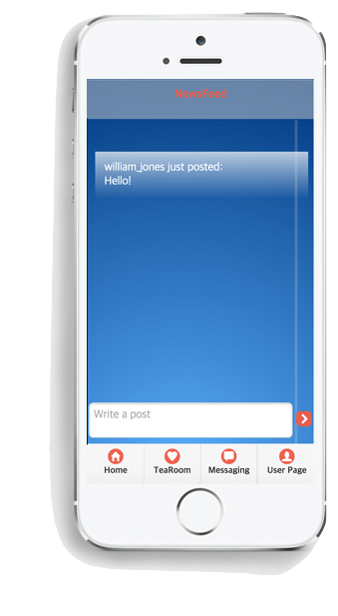
Newsfeed
Notes:
The first page you will be directed to is the newsfeed where you are able to post news and other updates about your project to everyone that is in your team, as well as reading others posts.
Nathalie

Slide 8
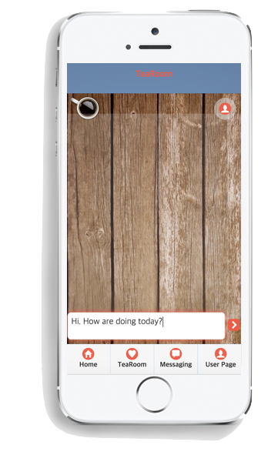
TeaRoom
Notes:
This page is the TeaRoom which the client wanted to be allocated chatting topics that are not work-related. This can be everything from asking people about their interests to asking about any movie preferences they have lately.
Nathalie

Slide 9
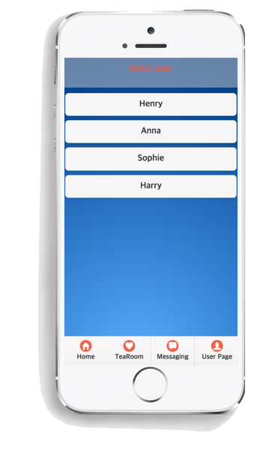
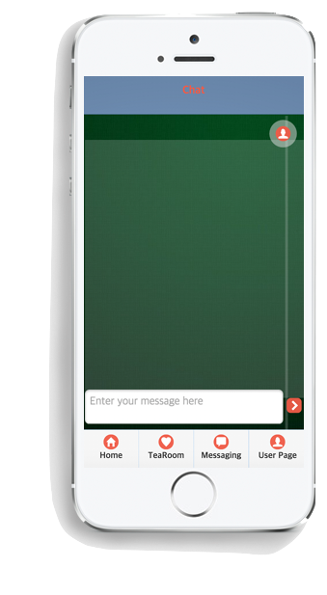
Private Chat
Notes:
The next page is the private chat, which allows you to pick one of the users in your team to chat with privately.
Nathalie

Slide 10
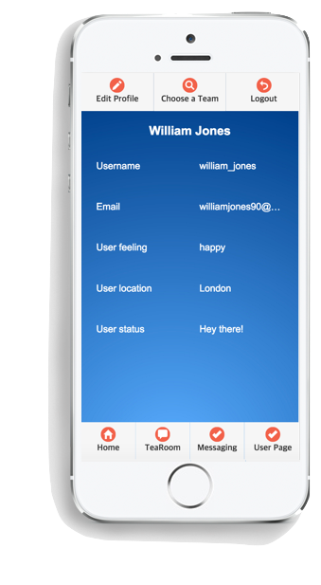
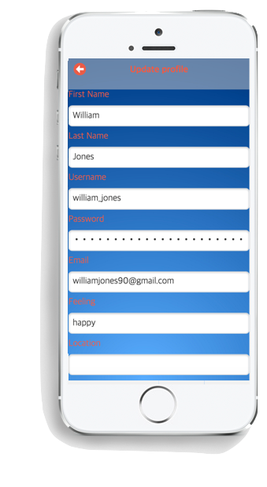
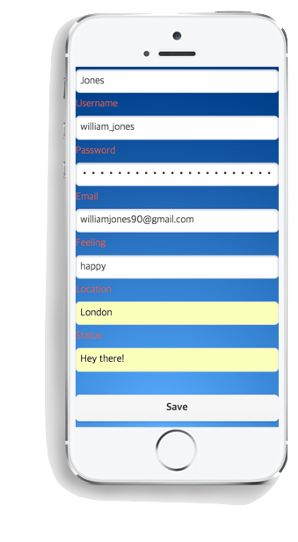
User Page
Notes:
This is the profile page where you can see all of your personal information, where you can simply change your settings from this button…, and update your status and location.
Nathalie

Slide 11






Development– Front end
Notes:
So how did we build this mobile app?
We have actually used web technologies to build the app using HTML, CSS and JavaScript. To simplify many of the functions we have used jQuery, and we have also used jQuery Mobile for both functionality and design where jQuery Mobile provides many design features that fits for mobile development.
Our chat functionality is used by using a third party SDK for JavaScript, and is being reused in the app through the newsfeed, tearoom and the private messaging.

Slide 12
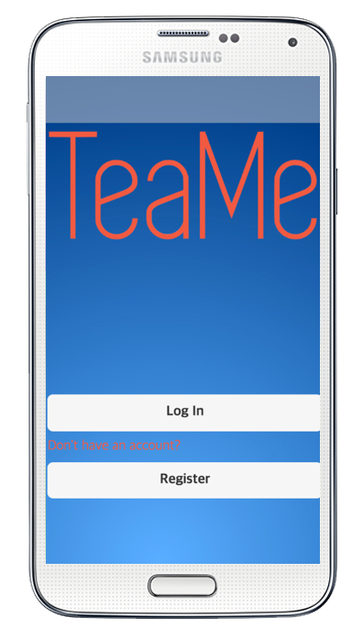
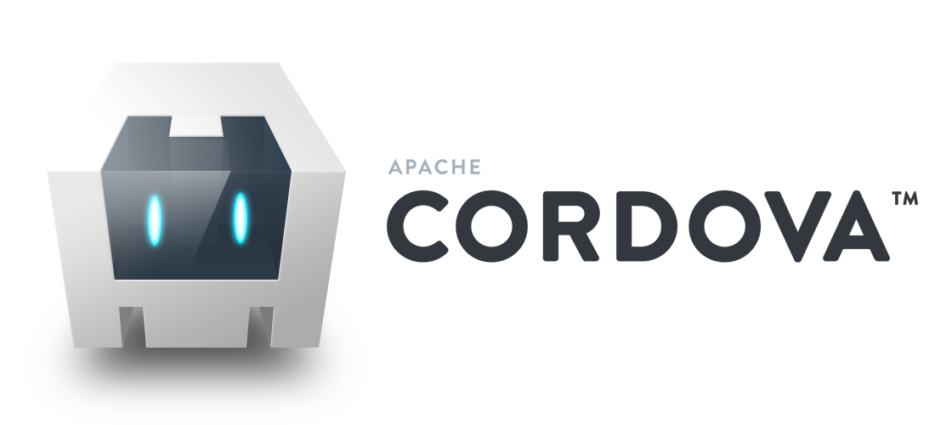
Converting to mobile app
+
Notes:
You might ask yourself, why did they build a mobile app in web technologies and how does this create a mobile app? The reason is that the client wanted the app to be cross platform, so we have therefore used Apache Cordova which is a wrapper that turns our HTML, CSS and JavaScript into native Objective C and Java code depending if you want an iOS app or an Android app.

Slide 13



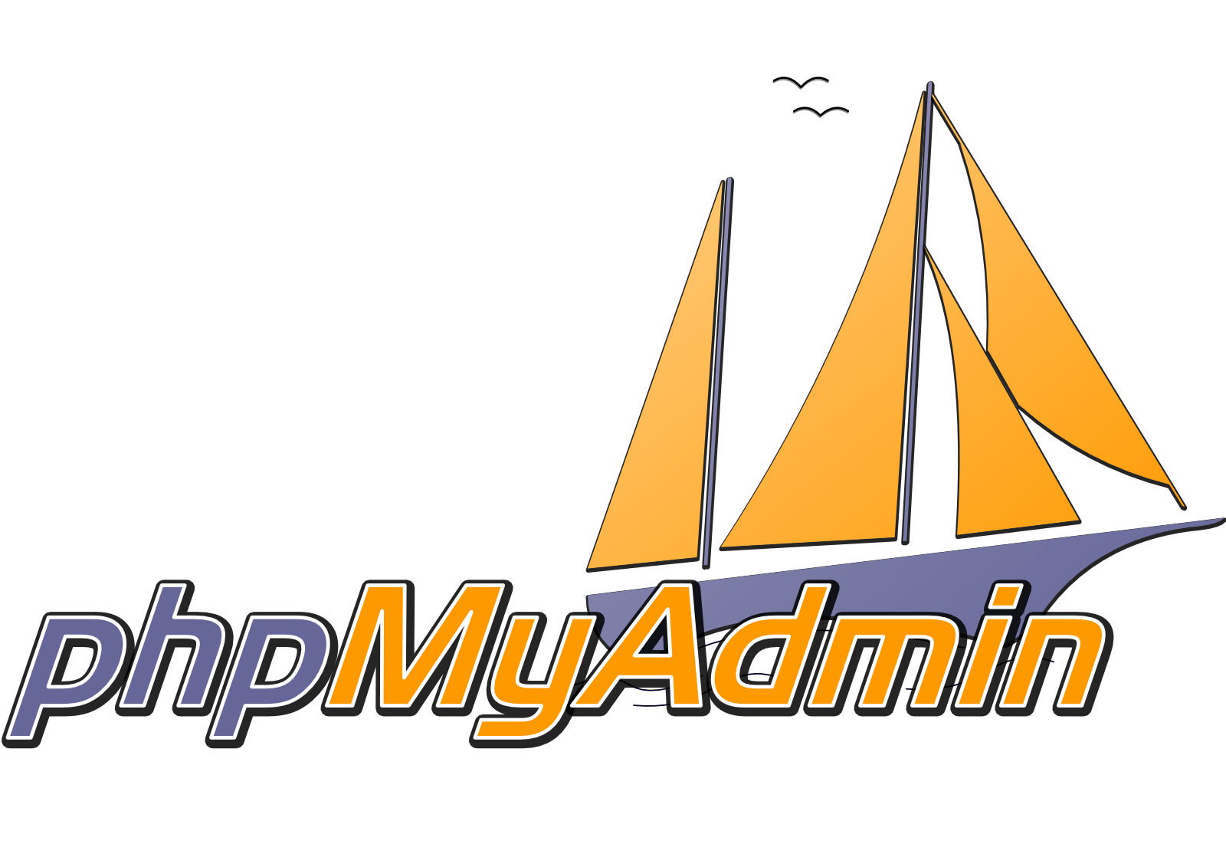
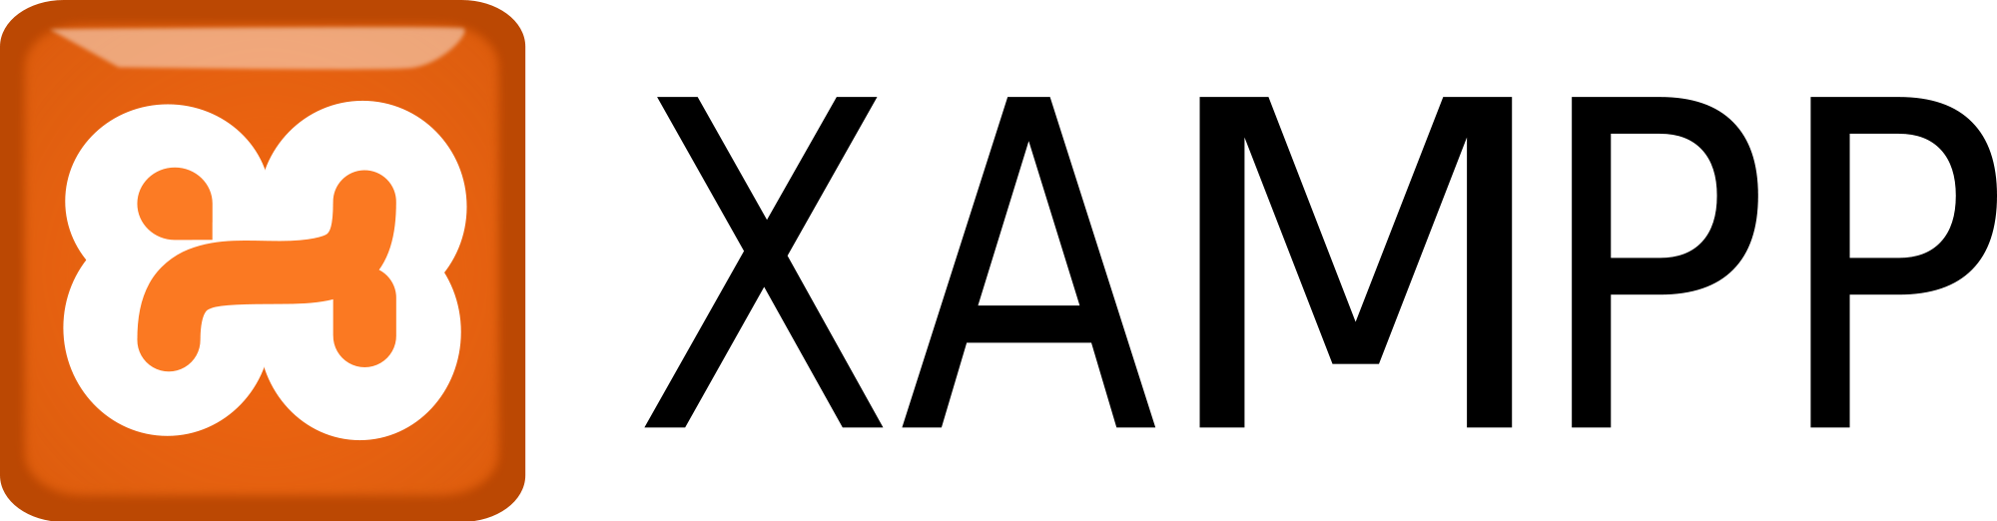
Development– Back end
Notes:
Laman

Slide 14
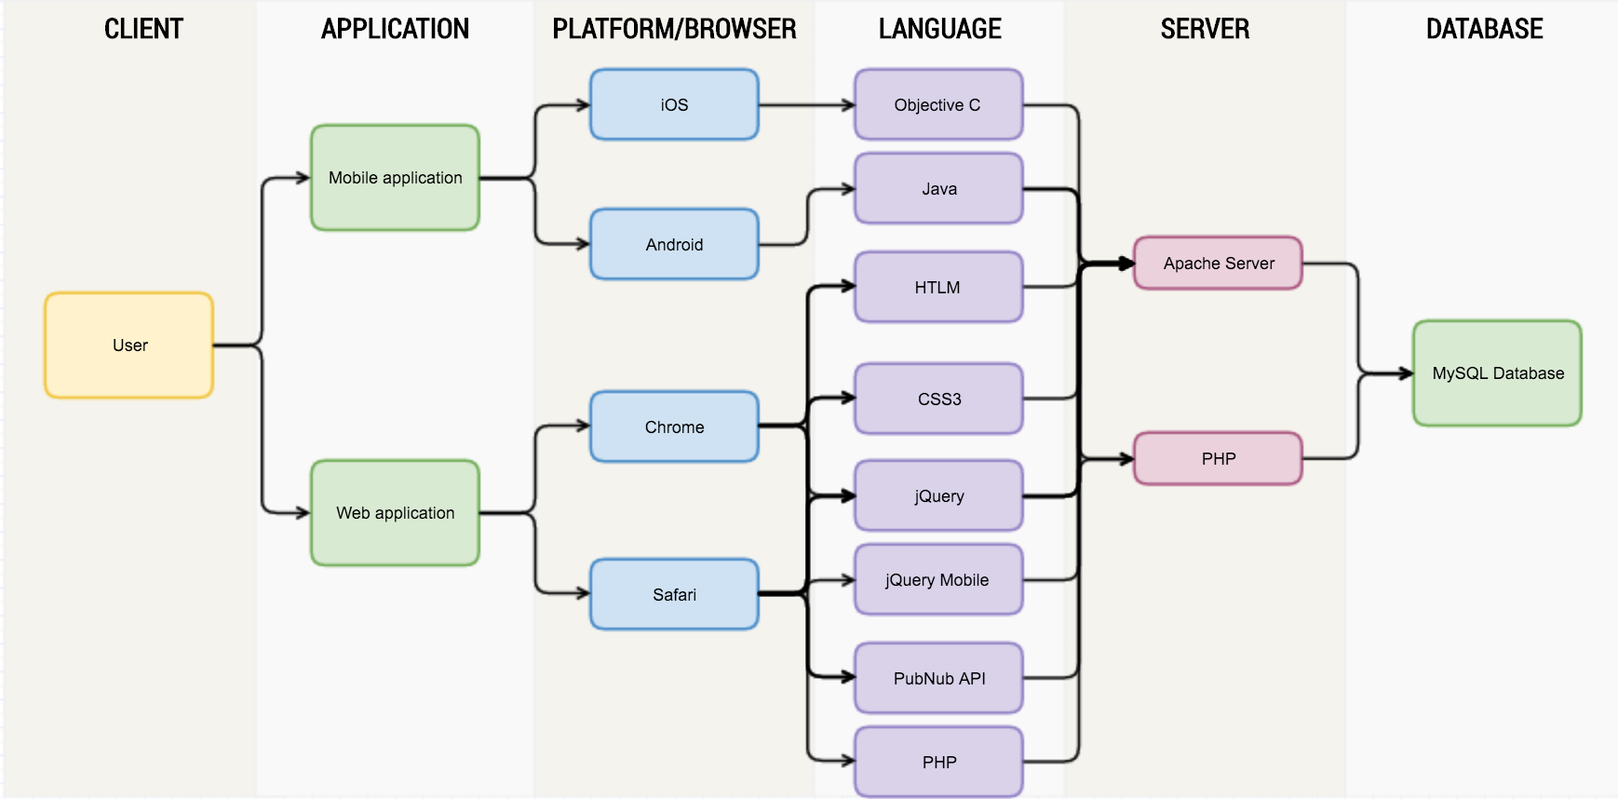
Architecture Flow
Notes:
This is briefly the architecture of the app where the user can either use a mobile or web application, which are powered by different platforms. The platforms are run by different languages, which later on connects to a server, which talks to the database.

Slide 15

Testing the system
User-acceptance testing
Testing use cases
Finding problems
Fixing errors
Passing test cases
User experience testing
Questionnaires
Feedback
Notes:
Laman

Slide 16
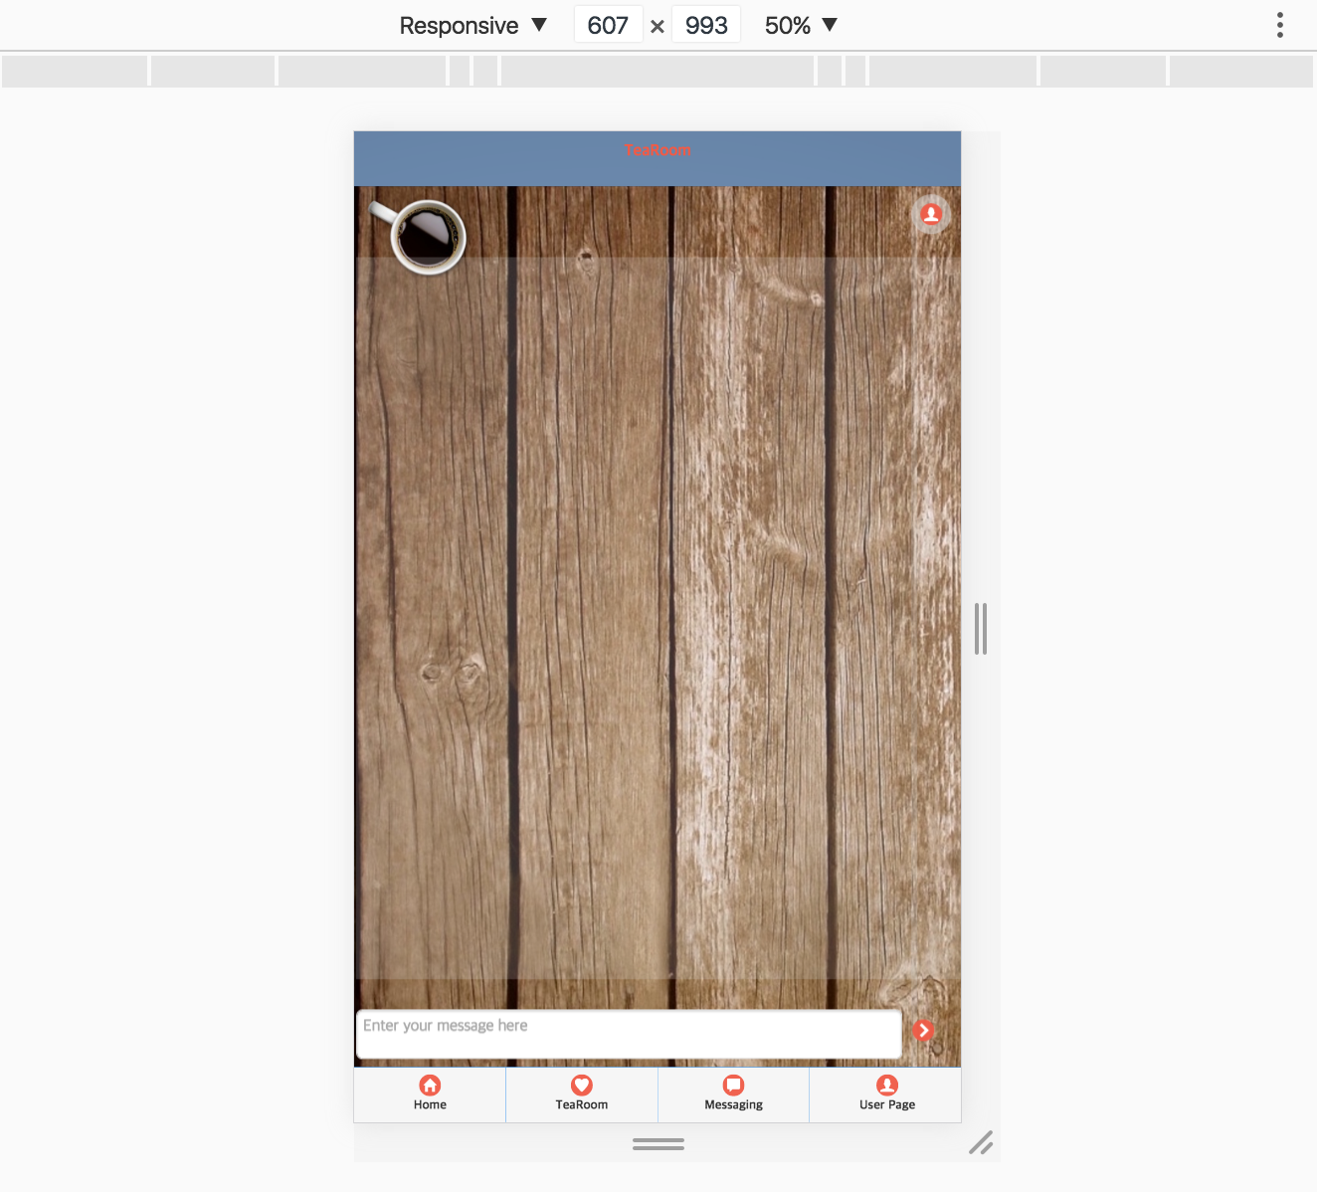
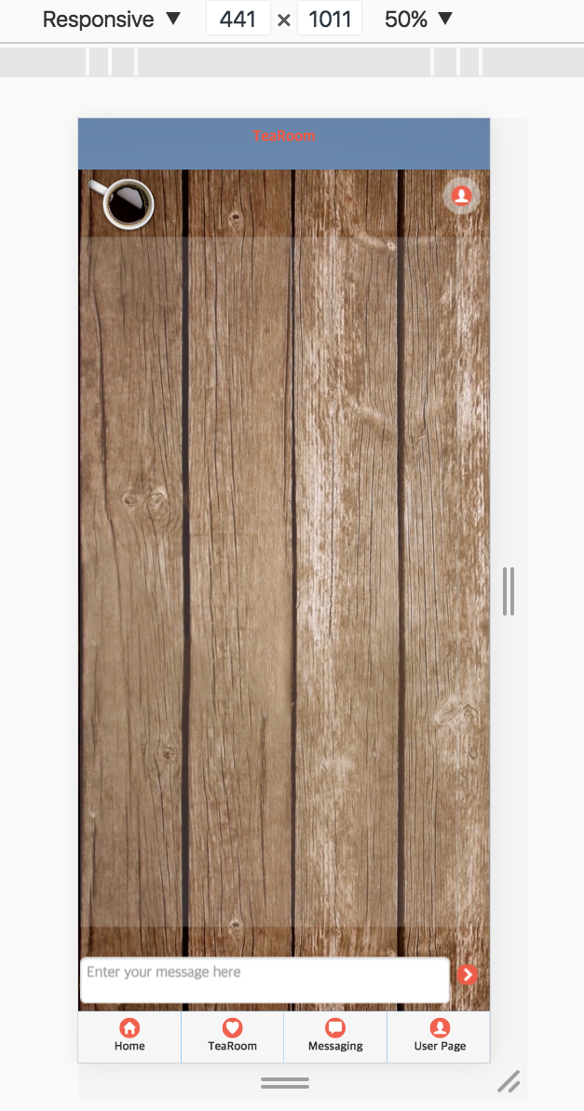
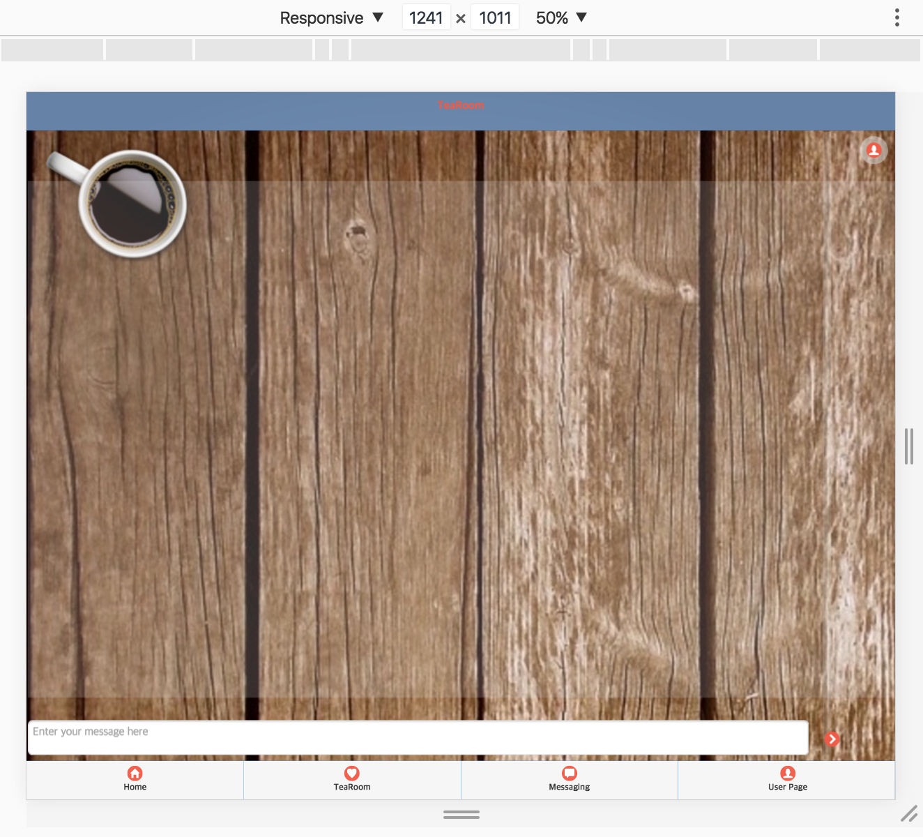
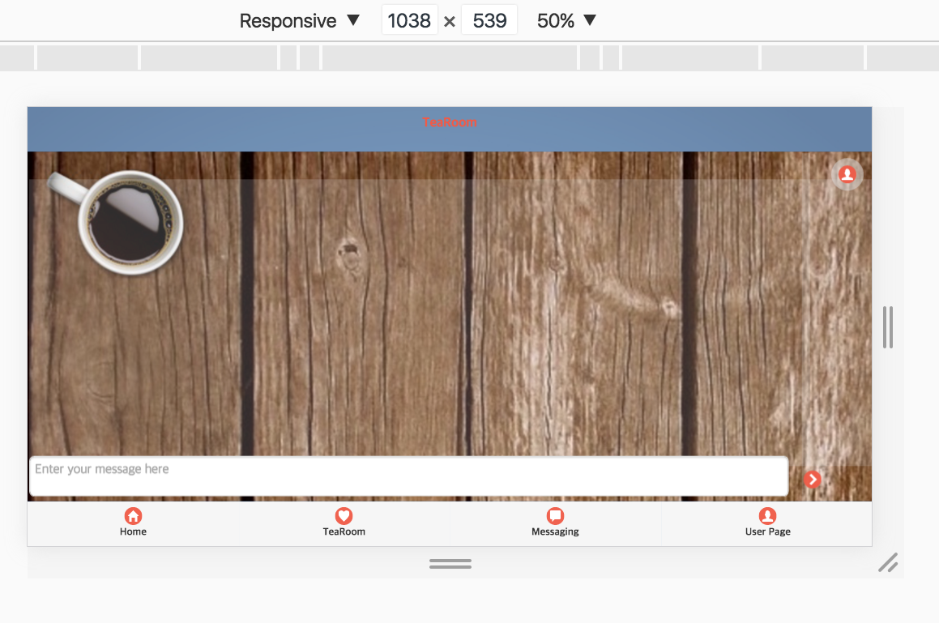
Testing the system
Responsive design testing
Notes:
Laman

Slide 17
Testing the system
Cross platform testing
Notes:
Laman

Slide 18

Evaluation
Successes
Failures
Satisfactory interface
Database management
Responsiveness
Chat
Newsfeed
TeaRoom
Private Chat
Pubnub restrictions
Error messages
Security
Notes:
Laman

Slide 19

Future directions
Improve UI/UX
Facebook login
External server
PubNub – multiple channels
Management system
Make available for production
Notes:
For future implementation we would like to improve the user interface and the user experience, where the design can be improved. E.g. the profile page could have included a picture and a more interactive UI for it to feel better to use.
We would also like to make the login system using the facebook API or Google+.
At the moment we are running our app on a local server on our laptops, so for the future it would be better to have an external server such that the app can run all the time and for the database to be accessible for everyone.
For the chats we would also like to implement the method to chat with multiple people at the same time, but was a problem because of restrictions from PubNub.
Another idea that the client wanted for the future was to generate reports to the manager of the team updating them with how the users are feeling.
Lastly, we would eventually want to make this app available for production when all security issues are resolved, and hopefully publish it in the AppStore and on the Google play store.
Nathalie

Slide 20
Conclusion & Final Thoughts
Help remote workers
Keep in touch
Life balance
Manage team
Understand others
Notes:
TeaMe is therefore helping employees working remotely to connect with the other people in their team and to keep in touch in a social way.
It will open up for a more open work environment behind the screens and will be easier to manage a team by understanding how people are feeling.
Talk about how it will help remote workers
What’s good about the application
Nathalie

Slide 21
THANK YOU
Q&A
NATHALIE VON HUTH & LAMAN MAMMADOVA

